Slide 1
Welcome Back to School
and
Welcome to Mrs. Romero’s Computer Class!

Slide 2
Classroom Rules
Listen and follow directions.
Respect others.
Stay on your class website.
Do NOT visit sites not on your class page.
Stay in your seat.
You may help those next to you with your voice but not your hands. Only touch your own computer and mouse.

Slide 3
Give Me 5!!!
When you hear the bell or when lights flicker,
Stop what you are doing.
Eyes are on the teacher.
Ears are listening.
Hands and feet are still.
Lips are closed.

Slide 4
Be Patient!!
When you have a question, raise your hand and wait for me to come to help you. Do not leave your seat to come get me. I am excited to help each of you but you will sometimes have to wait your turn.

Slide 5
Print only with permission

Slide 6
During a Fire Drill
Do not turn off computers.
Push your chair in when leaving. Why?
Leave quickly and quietly using the route the teacher gives to you.
No talking!!

Slide 7
What will we learn this year?
The different parts of the computer
How to use a computer
How to use different computer programs
How computers help us learn
Internet Safety
Computers are fun

Slide 8
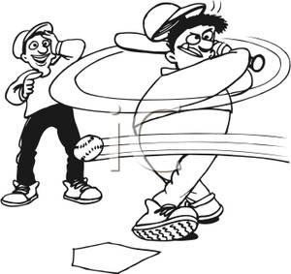
3 Strikes and You’re Out!!
1st time warning
2nd time warning
3rd time- break from the computer

Slide 9
When you leave the lab
Exit programs
Make sure your workspace is the way you found it- neat and organized.
Put away headphones.
Wait quietly at your seats until dismissed.

Slide 10
POP QUIZ!
Do You remember the classroom rules?

Slide 11
What do you do during a fire drill?
A. Run to the door.
B. Turn off the computer.
C. Leave quickly and quietly using the route the teacher has given you.

Slide 12
The answer is:
C. Leave quickly and quietly using the route the teacher has given you.

Slide 13
Which is not a computer lab rule?
A. Stay on your class website.
B. Print all your work.
C. Respect others.

Slide 14
The answer is:
B. Print all your work.

Slide 15
If you have a question, you should
A. Raise your hand and wait quietly.
B. Leave your seat and come ask me the question.
C. Shout the question out for all the class to hear.

Slide 16
The answer is:
A. Raise your hand and wait quietly.

Slide 17
If you get three strikes:
A. You will get to keep working at the computer.
B. You will get a prize.
C. You will have to take a break from working on the computer.

Slide 18
The answer is:
C. You will have to take a break from working on the computer.

Slide 19
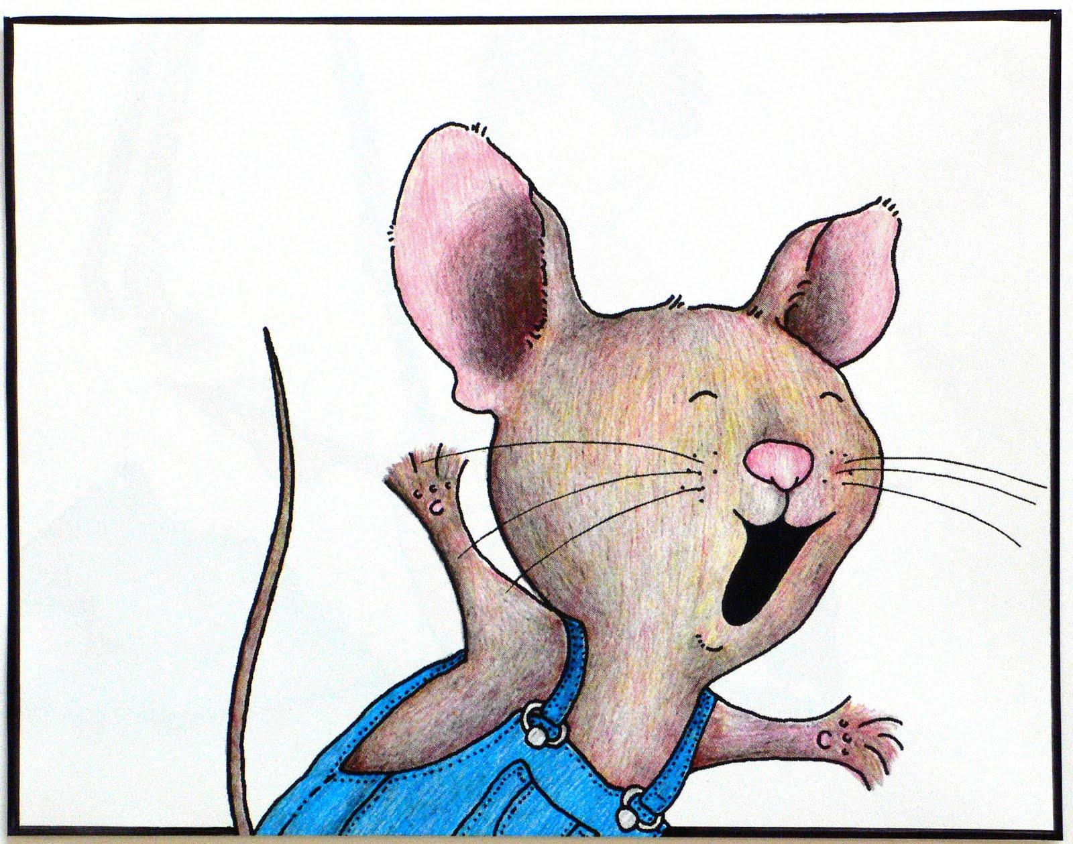
YOU PASSED THE QUIZ!!!!!
Time for computer learning and fun. It will be a great year!

